Slide 1
Professor
Jorge Alfonso Meléndez Acuña

Slide 2
Welcome

Slide 3
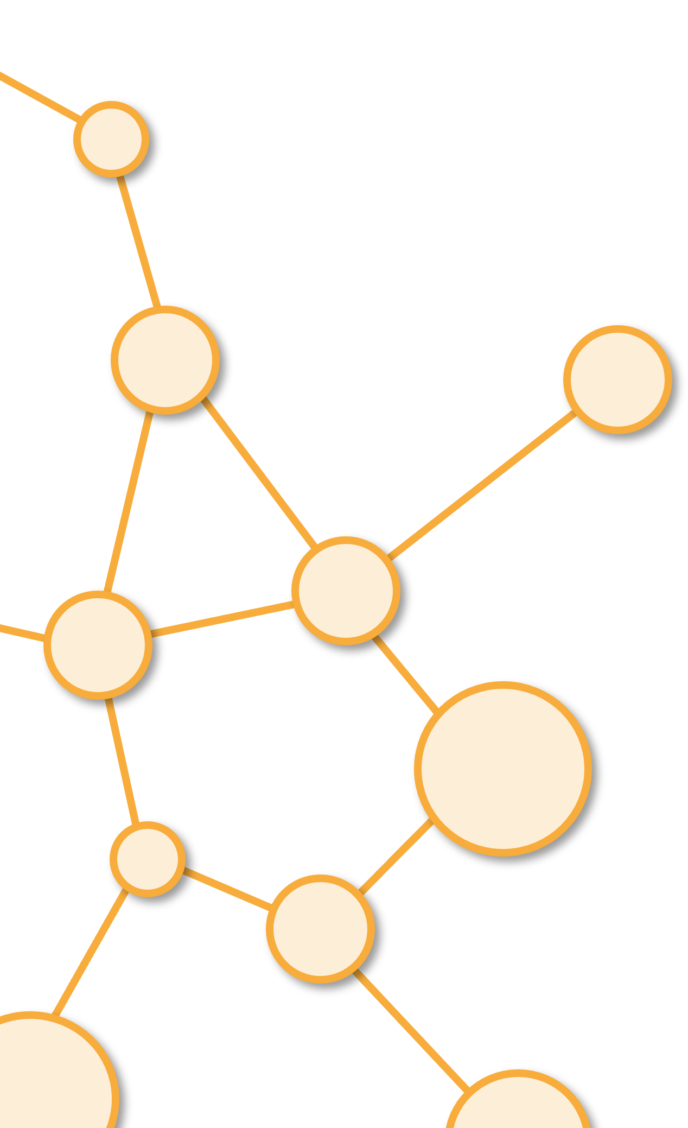
Why Communities

Slide 4
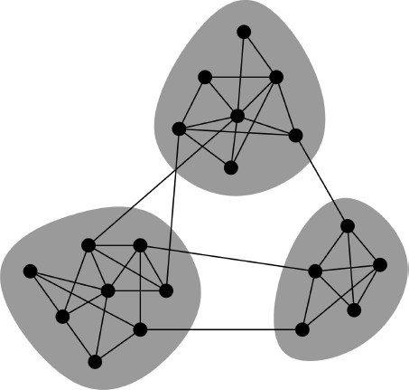
Networks and Communities
We often think of networks “looking” like this:
What led to such a conceptual picture?

Slide 5
Networks Flow of Information
How does information flow through the network?
People are “embedded” in a social network.
There are different links (“short” vs. “long”) in the network, through which information flows.
: person
: “short” link
: “long” link

Slide 6
Flow of Job Information
How do people find out about new jobs?
Mark Granovetter, part of his PhD in 1960s
People find the information through personal contacts
But: Contacts were often acquaintances rather than close friends
This is surprising: One would expect your friends to help you out more than casual acquaintances
Why is it that acquaintances are most helpful?
: “close-friend” link
: “acquaintance” link
Personal contact network

Slide 7
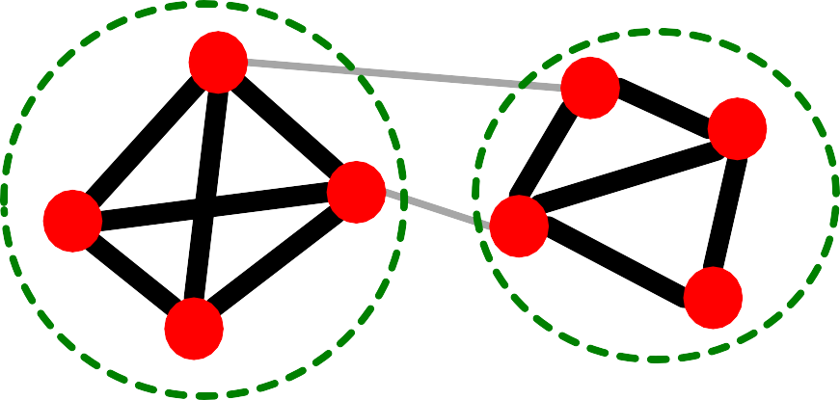
Granovetter’s Answer
Two perspectives on friendships:
Structural: Friendships span different parts of the network
Interpersonal: Friendship between two people is either strong or weak
Interpersonal

Slide 8




Granovetter’s Explanation
Granovetter makes a connection between the social and structural role of an edge
First point: Structure
Structurally embedded (tightly-connected) edges are also socially strong
Long-range edges spanning different parts of the network are socially weak
Second point: Information
Long-range edges allow you to gather information from different parts of the network and get a job
Weak
Structurally embedded edges are heavily redundant in terms of information access
S
Strong
S
W S
b
S

Slide 9
Triadic Closure
How community (tightly-connected cluster of nodes) forms?
Which edge is more likely, a-b or a-c?
a
If two people in a network have a friend in common, then there is an increased likelihood they will become friends themselves.
b
c

Slide 10
Reasons for Triadic Closure
Triadic closure = High clustering coefficient
Reasons for triadic closure:
If 𝑩 and 𝑪 have a friend 𝑨 in common, then:
𝑩 is more likely to meet 𝑪
B
(since they both spend time with 𝑨)
𝑩 and 𝑪 trust each other
(since they have a friend in common)
𝑨 has incentive to bring 𝑩 and 𝑪 together
A
C
(since it is hard for 𝑨 to maintain two disjoint relationships)
Empirical study by Bearman and Moody:
Teenage girls with low cluster coefficient are more likely to contemplate suicide

Slide 11
Edge Strength in Real Data
For many years Granovetter’s theory was not tested
But, today we have large who-talks-to-whom graphs:
Email, Messenger, Cell phones, Facebook
Onnela et al. 2007:
Cell-phone network of 20% of EU country’s population
Edge weight: # phone calls

Slide 12
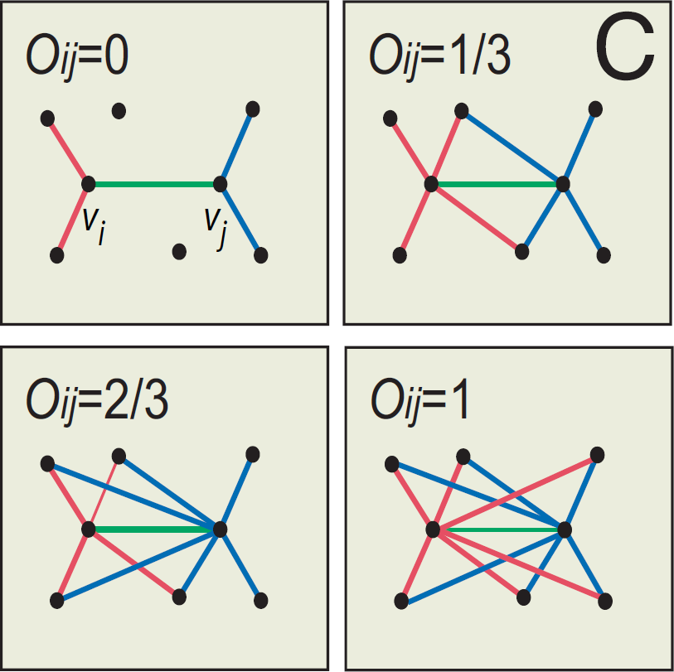

Edge Overlap
^{𝑂}𝑖j
₌ |(𝑁(𝑖) ⋂ 𝑁 𝑗 ) − {𝑖, 𝑗}|
|(𝑁(𝑖) ⋃ 𝑁 𝑗 ) − {𝑖, 𝑗}|
𝑁(𝑖) … the set of neighbors of node 𝑖
Note: Overlap = 𝟎 when an edge is a local bridge

Slide 13
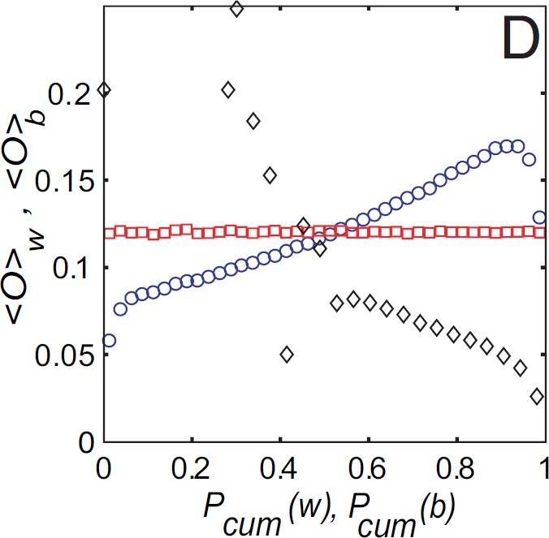
Phones : Edge Overlap over Strength
Cell-phone network
Observation:
Highly used links have high overlap!
True
Neighborhood overlap
Permuted strengths
Legend:
True: The data
Permuted strengths: Keep the network structure
but randomly reassign edge strengths
Edge strength (#calls)

Slide 14
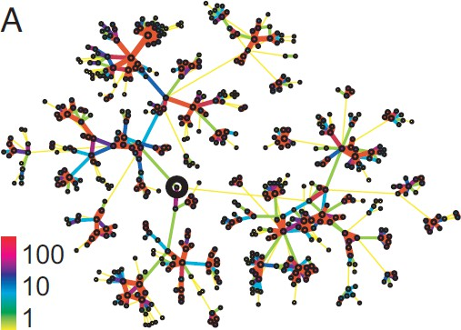
Real Networks Real Edge Strengths
Real edge strengths in mobile call graph
Strong ties are more embedded (have higher overlap)

Slide 15
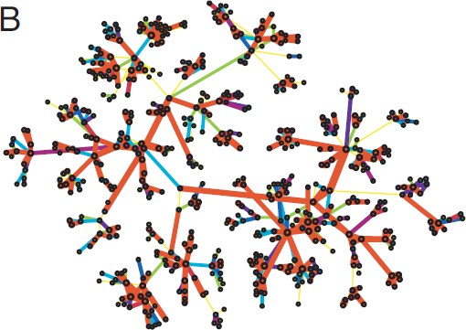
Real Net, Permuted Tie Strengths
Same network, same set of edge strengths
but now strengths are randomly shuffled

Slide 16
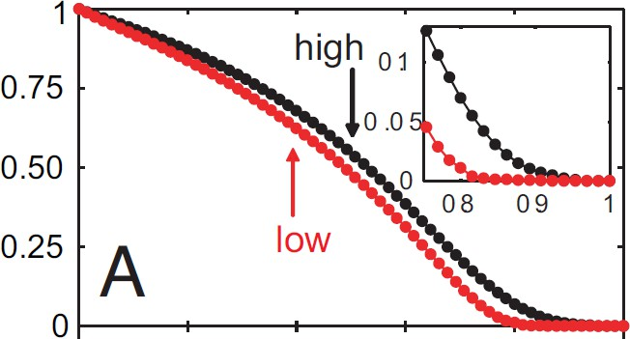
Removing edges based on strength (#calls)
Low to high
High to low
Size of largest component
Low disconnects the network sooner
Conceptual picture of network structure
Fraction of removed edges

Slide 17
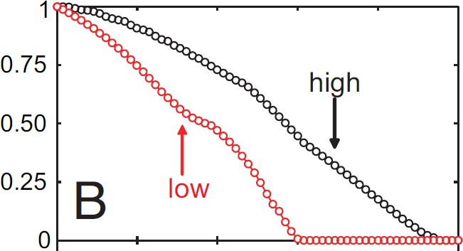
Removing edges based on edge overlap
Low to high
High to low
Size of largest component
Low disconnects the network sooner
Conceptual picture of network structure
Fraction of removed edges

Slide 18
Conceptual Picture of Networks
Granovetter’s theory leads to the following conceptual picture of networks
Strong ties/edges
Weak ties/edges

Slide 19
Good bye

Slide 21
Credits
Subject Matter Expert
Instructional Designer
Jorge Alfonso Meléndez Acuña
Angela Maria Arboleda Restrepo
Subject Matter Expert
Graphic Designer
Luis Fernando Niño Vásquez
Tania Valentina Flórez Rincón
First version
Date: April 2025

